Slide 1
Forward and backward errors

Slide 2
Find an approximation x_{r} of f(x)=0 with an error below a given tolerance TOL
Algorithm
x_{i}
x_{i+1}
x_{r}
Error < TOL
Error > TOL
Notes:
So far we learned various methods to solve numerically an equation.
These methods produce successive approximations xi of the solution of the equation f(x)=0.
We learned how to estimate the errors and how we can decide if we reached the desired tolerance.
This allowed us to give the numerical solution xr which approximates the true solution r of the equation with an error below the desired tolerance.
However, as an engineer you want to be able to check your answer.
You would like to be able to have a method independent of the used algorithm to verify that xr is indeed the solution of your equation.
Why is this important ?

Slide 3

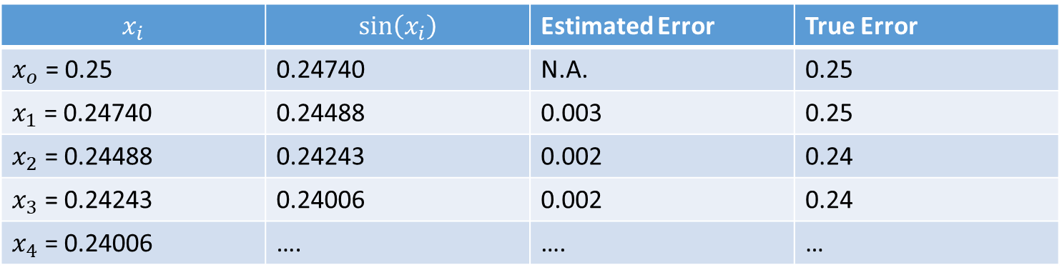

$$x=sin⁡(x)$$
$$x_{i+1}=sin⁡\left(x_{i}\right)$$
$$x_{i}$$ | $$sin⁡\left(x_{i}\right)$$ | Estimated Error | True Error
$x_{o}$ = 0.25 | 0.24740 | N.A. | 0.25
$x_{1}$ = 0.24740 | 0.24488 | 0.003 | 0.25
$x_{2}$ = 0.24488 | 0.24243 | 0.002 | 0.24
$x_{3}$ = 0.24243 | 0.24006 | 0.002 | 0.24
$x_{4}$ = 0.24006 | …. | …. | …
Notes:
Recall the example of the equation sin(x)=x we solved numerically using the fixed point method.
Even when applying perfectly correctly the algorithm and the method to estimate the error we still get a wrong answer.
Indeed, the values we get from the algorithm and their error estimations are wrong.
We largely underestimate the error in this example.
Without the knowledge of the true solution, we wouldn’t be able to know that we estimate wrongly the solution and the associated error.

Slide 4
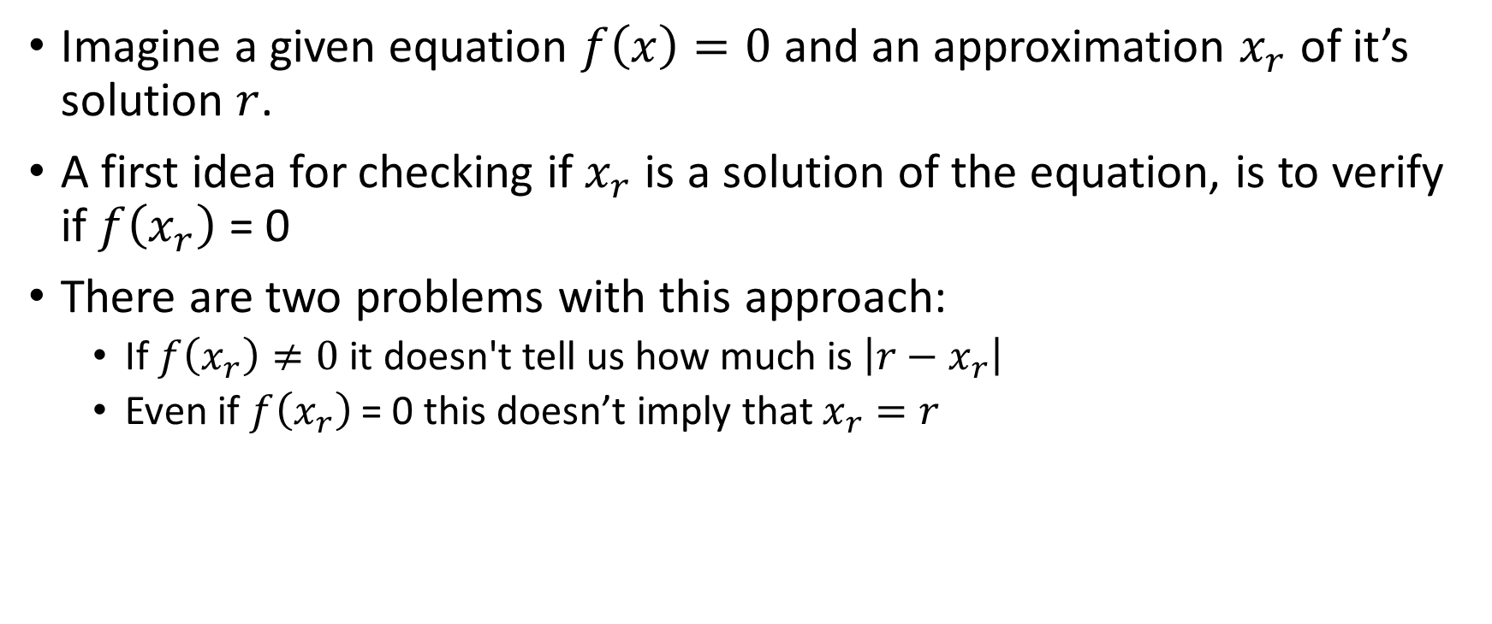
How to check if an approximation is acceptable?
Imagine a given equation $f\left(x\right)=0$ and an approximation $x_{r}$ of it’s solution $r$.
A first idea for checking if $x_{r}$ is a solution of the equation, is to verify if $f\left(x_{r}\right)$ = 0
There are two problems with this approach:
If $f\left(x_{r}\right)≠0$ it doesn't tell us how much is $\left|r−x_{r}\right|$
Even if $f\left(x_{r}\right)$ = 0 this doesn’t imply that $x_{r}=r$
Notes:
So how can we check if an approximation is acceptable or not?
What we have at hand are two things. On one side we have the equation f(x)=0 that we want to solve.
On the other side we have the approximation xr produced by the algorithm
How do we check if xr is a root of f(x)?
So far in mathematics you have learned : to check if xr is a root of f(x) simply compute f(xr). If you get zero, xr is indeed a root.
Numerically this approach has two major issues
First, as xr is only an approximation of the root r you will not find that f(xr)=0. You will find some value. Maybe the value is close to zero, but independently on how much you find for f(xr), this doesn’t really tell you how far away you are from the root.
And second, as we will see in next lecture, even if f(xr)=0, this does not mean that xr is a root. This sounds very surprising and against all you have learned so far in mathematics.
But as we will see this statement is unfortunately true. The reason of it will become clear in next lecture.

Slide 5

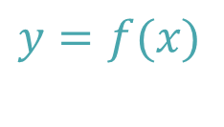




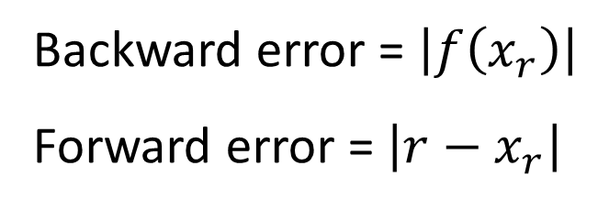
Forward and backward errors
$$y$$
$$y=f(x)$$
Backward error = $\left|f\left(x_{r}\right)\right|$
Forward error = $\left|r−x_{r}\right|$
$$f\left(x_{r} \right)$$
Backward Error
$$r$$
$$x_{r}$$
$$x$$
Forward Error
Notes:
Let us have a closer look to the situation at hand.
We have a function y=f(x)
This function has a root in x=r.
Further we have the approximation xr of this root
By trying to check if xr is root by evaluation f(xr), the only element we find is how much is f(xr).
In numerical analysis this quantity is called the backward error.
The backward error is the error you get when you plug back your approximation into the original problem.
If xr would be the root f(xr) would be equal to zero.
We do not get zero. The difference of f(xr) with the value we should get is called the backward error.
But the knowledge of the backward error doesn’t tell us how far xr is from r.
We are interested in how much is the difference between the root r and the approximation xr.
This difference is called the forward error.
Backward errors and forward errors are two very important concepts in numerical analysis. And they should not be mixed up
The backward error is always accessible as we can always calculate it
However the forward error is unknown.
But we would like to estimate this forward error.
In the example of out figure, forward error and backward error are about the same magnitude.
But this is not always the case.

Slide 6












Forward and backward errors
$$y$$
$$y=f(x)$$
$$y$$
$$y=f(x)$$
$$f\left(x_{r} \right)$$
Backward Error
$$f\left(x_{r} \right)$$
$$r$$
$$x_{r}$$
$$r$$
Backward Error
$$x$$
$$x_{r}$$
$$x$$
Forward Error
Forward Error
Notes:
Here we show two other cases
On the first one, on the left figure, the forward error is smaller than the backward error
On the other hand, for the right figure exactly the opposite situation happens. The forward error is larger than the backward error.

Slide 7





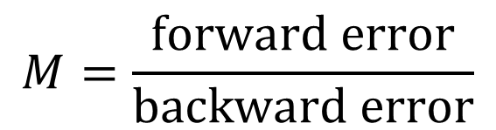


Error Magnification Factor
$$y$$
The ration between forward and backward error is the error magnification factor $M$:
$$y=f(x)$$
$$f\left(x_{r} \right)$$
$$M=\frac{\text{forward} \text{error}}{\text{backward} \text{error}}$$
Backward Error
$$r$$
$$x_{r}$$
$$x$$
Forward Error
Notes:
As forward error and backward errors can relate very differently, one likes to introduce the error magnification factor.
The error magnification factor M is the ratio between forward and backward error.
The larger M is, the larger the forward error is compared to the backward error.

Slide 8




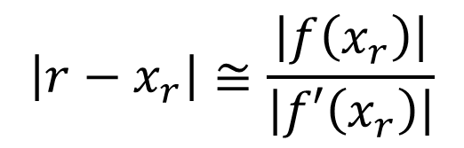



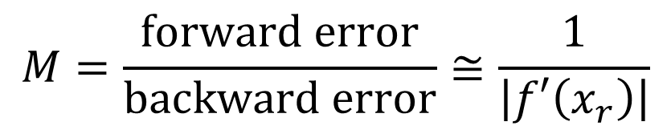
Forward Error Estimation
$$y$$
From the figure
Or alternatively
$$y=f(x)$$
$$M=\frac{\text{forward} \text{error}}{\text{backward} \text{error}}≅\frac{1}{\left|f′\left(x_{r}\right)\right|}$$
$$f\left(x_{r} \right)$$
$$f′\left(x_{r} \right)$$
Backward Error
$$\left|r−x_{r}\right|≅\frac{\left|f\left(x_{r}\right)\right|}{\left|f′\left(x_{r}\right)\right|}$$
$$r$$
$$x_{r}$$
$$x$$
Forward Error
Notes:
The value M of the error magnification factor will depend on the shape of the function.
Let me stress out that this value M does not depend on the particular algorithm that was used to find the approximation xr.
The error magnification factor M depends only on the shape of the function we want to find the root from.
From the figure one can immediately conclude that M is about the inverse of the slope of f(x) in xr.
Indeed, the slope of the function in xr, is approximatively the backward error divided by the forward error.
Alternatively you can write that the forward error is approximatively f(xr) divided by f’(xr).
This formula is very useful to estimate the forward error for a given approximation xr.

Slide 9
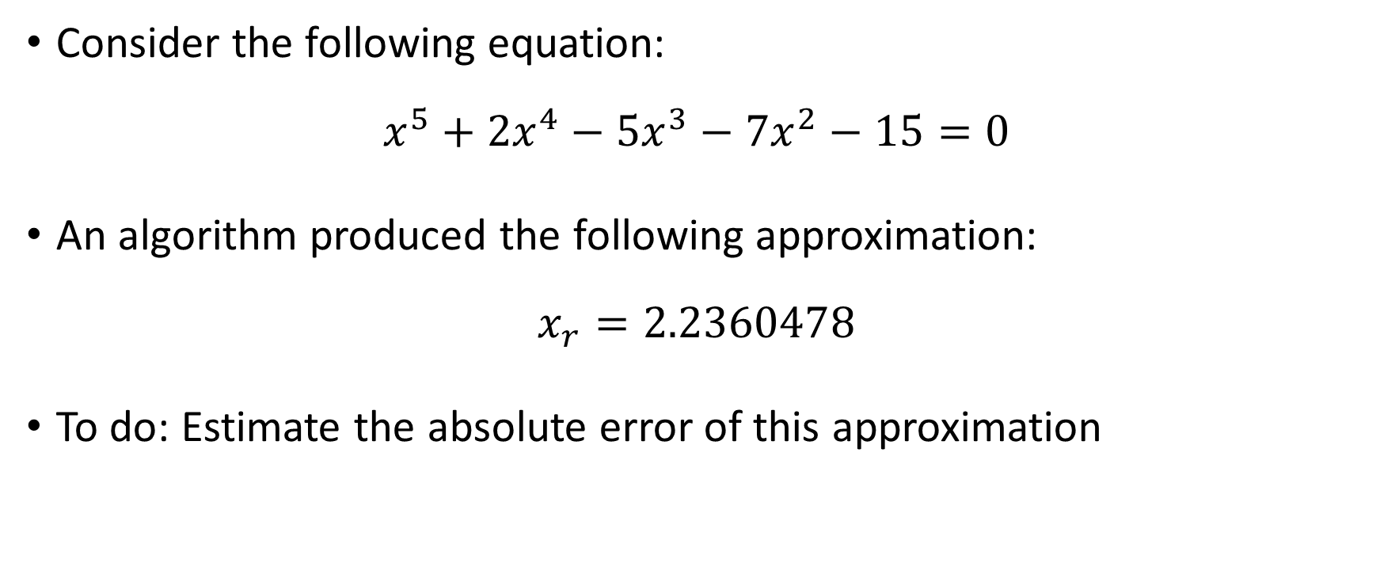
Application 1
Consider the following equation:
$$x^{5}+2x^{4}−5x^{3}−7x^{2}−15=0$$
An algorithm produced the following approximation:
$$x_{r}=2.2360478$$
To do: Estimate the absolute error of this approximation
Notes:
Let us do an application
Consider the displayed polynomial equation in power five.
Imagine you did run an algorithm and that the generated approximation xr is $2.2360478.$
Can we based on these two information estimate how much would be the forward error?
Or in other words: how much is approximatively the error of this approximation?
With the theory we developed so far it is possible to do this task.

Slide 10
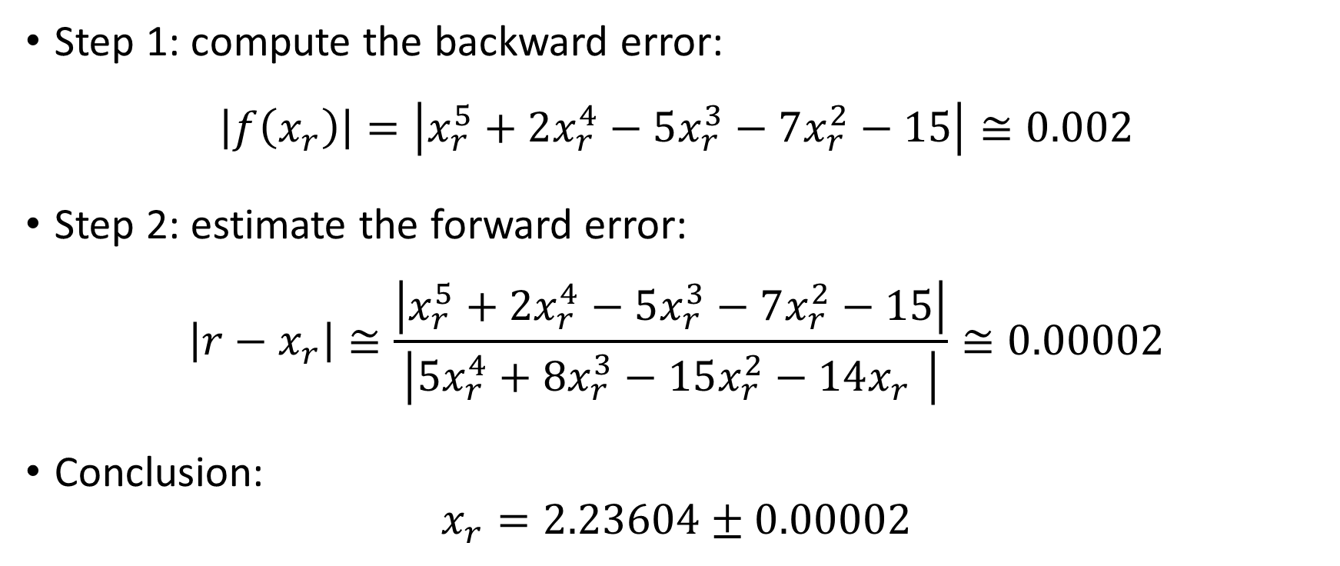
Application 1 - Solution
Step 1: compute the backward error:
$$\left|f\left(x_{r}\right)\right|=\left|x_{r}^{5}+2x_{r}^{4}−5x_{r}^{3}−7x_{r}^{2}−15\right|≅0.002$$
Step 2: estimate the forward error:
$$\left|r−x_{r}\right|≅\frac{\left|x_{r}^{5}+2x_{r}^{4}−5x_{r}^{3}−7x_{r}^{2}−15\right|}{\left|{5x}_{r}^{4}+8x_{r}^{3}−15x_{r}^{2}−14x_{r}^{}\right|}≅0.00002$$
Conclusion:
$$x_{r}=2.23604±0.00002$$
Notes:
First we can calculate the backward error. We find about 0.002.
The backward error in itself doesn’t tell us how far away we are from the true root. For this we must use our theory and divide the backward error by the slope of f(x) in the approximation xr.
In this example we get about 0.00002.
We can conclude that the root of f(x) is $2.23604±0.00002$
Note how you can estimate the error of an approximation totally independently of the used algorithm.

Slide 11
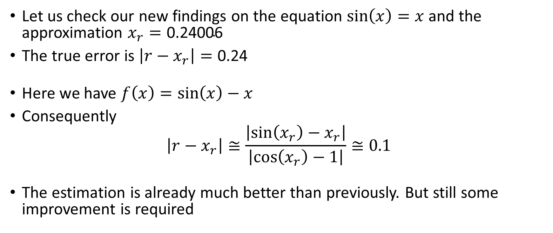
Application 2
Let us check our new findings on the equation $\sin\left(x\right)=x$ and the approximation $x_{r}=\text{0.24006}$
The true error is $\left|r−x_{r}\right|=\text{0.2}\text{4}$
Here we have $f\left(x\right)=sin\left(x\right)−x$
Consequently
$$\left|r−x_{r}\right|≅\frac{\left|\sin\left(x_{r}\right)−x_{r}\right|}{\left|\cos\left(x_{r}\right)−1\right|}≅0.1$$
The estimation is already much better than previously. But still some improvement is required
Notes:
Let us try a second example. For this we use the problem we started with the lecture.
We had the equation sin(x)=x and the approximation $x_{r}=\text{0.24006}$.
With the method we learned so far to estimate the errors, we found a way too small error estimation of about 0.002.
In fact in this case we know that the true error is about 0.24.
Will our new theory work better and give a better estimation of the error?
We have that f(x)=sin(x)-x
Consequently the forward error can be estimated as $\sin\left(x_{r}\right)−x_{r}$ divided by $\cos\left(x_{r}\right)−1$. For the approximation xr of 0.24006 we look at, we get a forward error of about 0.1
This error estimation is already better than previously, but still there is room for improvement. The estimation is still too optimistic.
In next lecture we are going to learn the reason why this equation seems so tricky to solve numerically. We are as well going to learn how we can get a better estimation of the error.

Slide 12
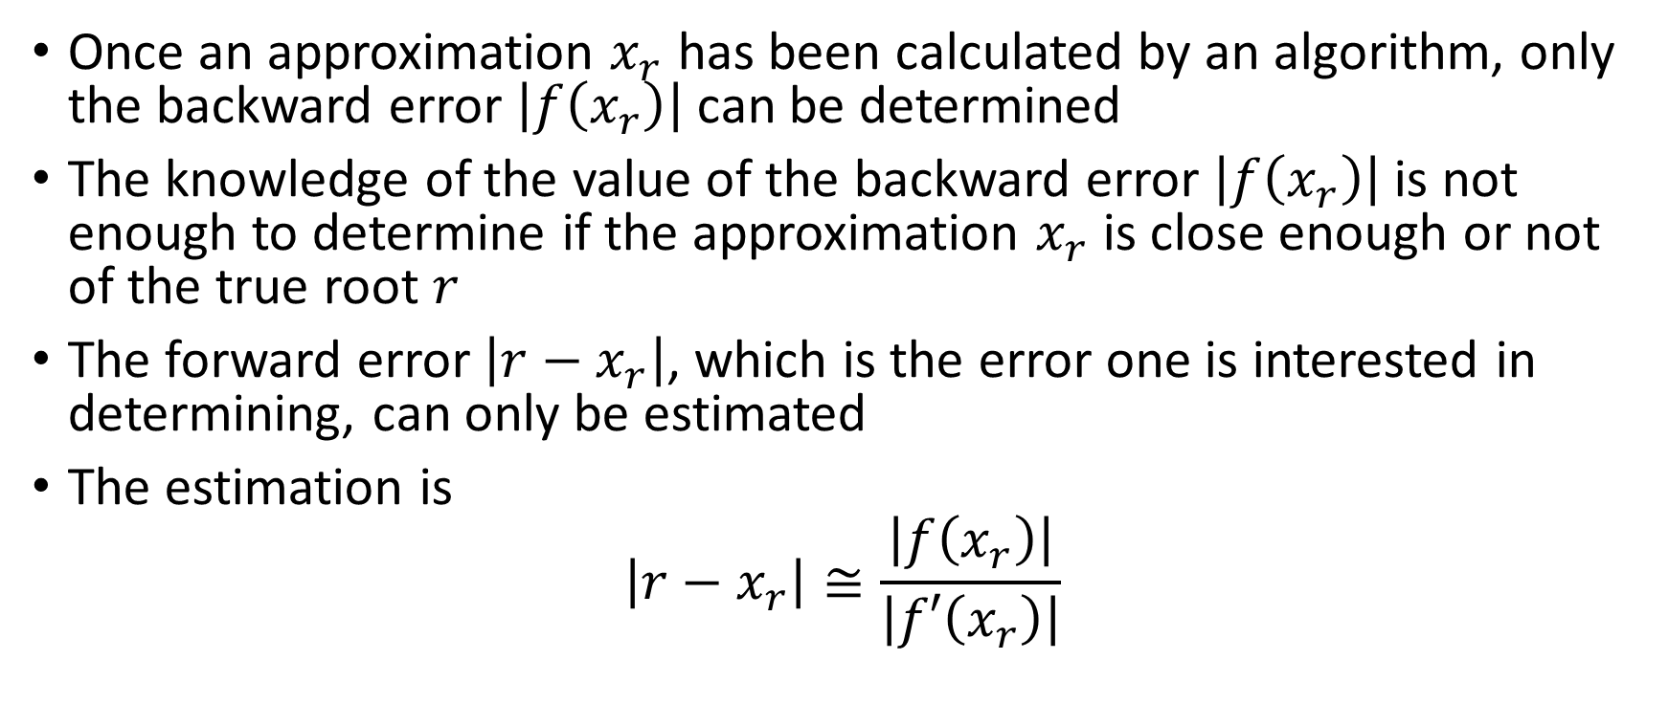
Summary
Once an approximation $x_{r}$ has been calculated by an algorithm, only the backward error $\left|f\left(x_{r}\right)\right|$ can be determined
The knowledge of the value of the backward error $\left|f\left(x_{r}\right)\right|$ is not enough to determine if the approximation $x_{r}$ is close enough or not of the true root $r$
The forward error $\left|r−x_{r}\right|$, which is the error one is interested in determining, can only be estimated
The estimation is
$$\left|r−x_{r}\right|≅\frac{\left|f\left(x_{r}\right)\right|}{\left|f′\left(x_{r}\right)\right|}$$
Notes:
Let us summarize the key findings
Once an approximation $x_{r}$ has been calculated by an algorithm, only the backward error $\left|f\left(x_{r}\right)\right|$ can be determined
The knowledge of the value of the backward error $\left|f\left(x_{r}\right)\right|$ is not enough to determine if the approximation $x_{r}$ is close enough or not of the true root $r$
The forward error $\left|r−x_{r}\right|$, which is the error one is interested in determining, can only be estimated
The estimation is$\frac{\left|f\left(x_{r}\right)\right|}{\left|f′\left(x_{r}\right)\right|}$

